Slide 1
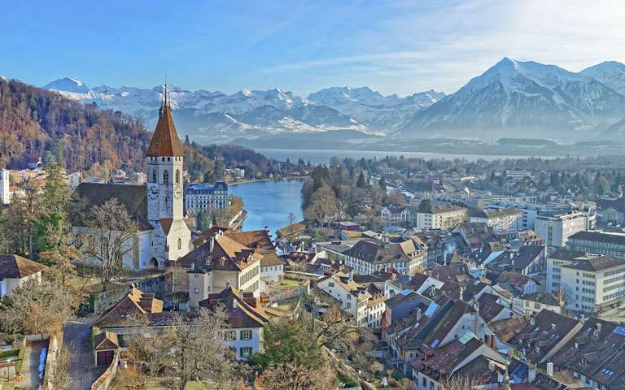
Rhineland
Pim Huisman – Concept / Environment Art
Scott Vetketel – Environment Art
Jens Walgien – Character Art
Jorrit Kornelis – Producer
Daniël Stremmelaar – Programmer / Game Design

Slide 2
Inhoud
Inspiratie
Art Style
Mechanics

Slide 3
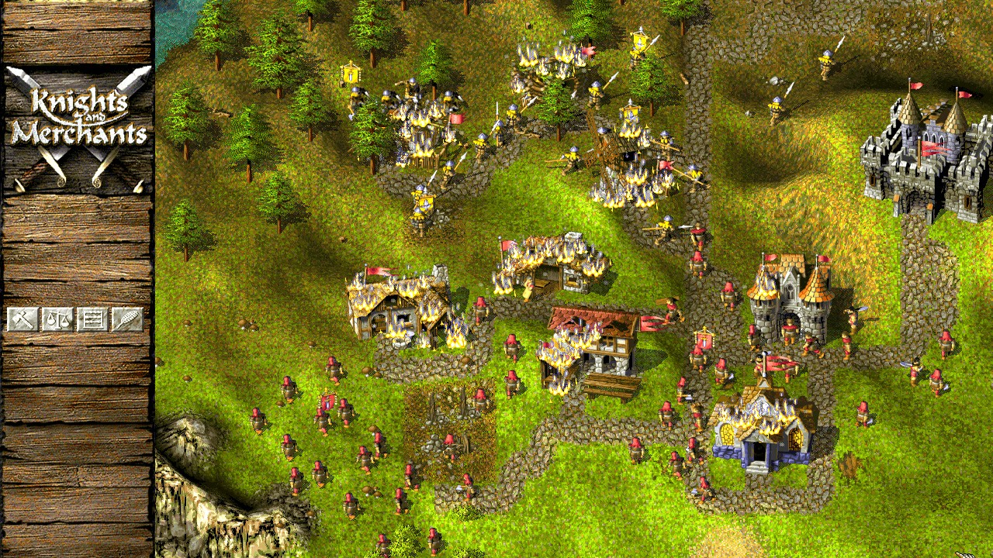
Inspiratie
Middel Eeuwen
Duitsland
Rheinland
Knights & Merchants
Northgard
Settlers

Slide 4
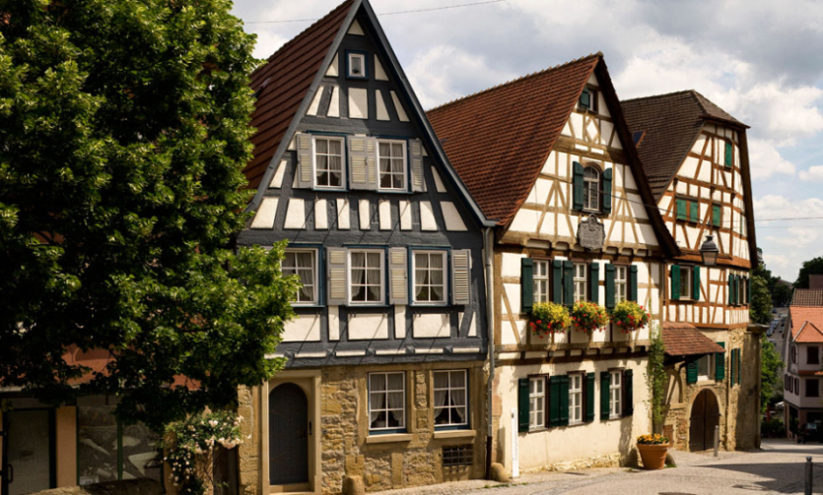
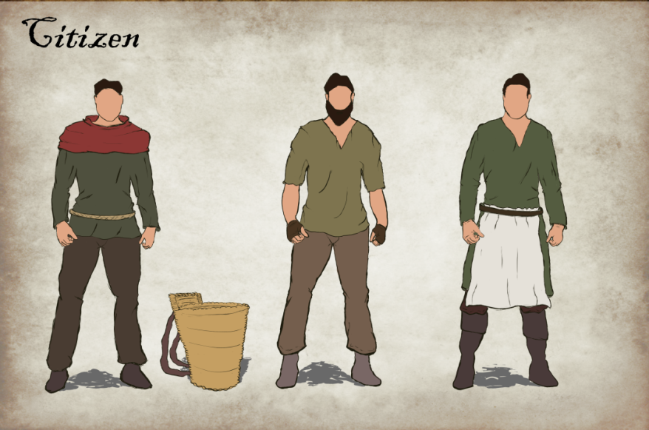
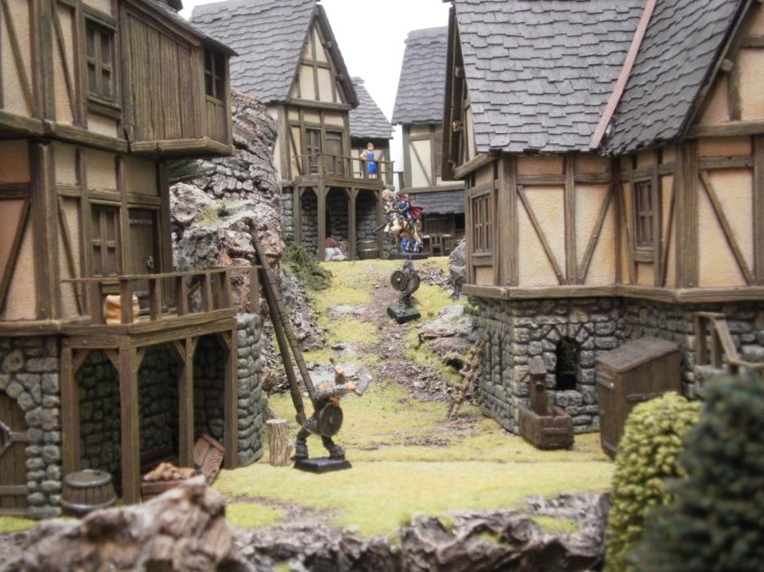
Art Style
Realistisch
Semi-historisch accuraat

Slide 5
Mechanics
Top down camera
Mouse controlled
Resource management
Starvation
Hapiness
Random events
Supply chain

Slide 6
Vragen?

